Slide 1
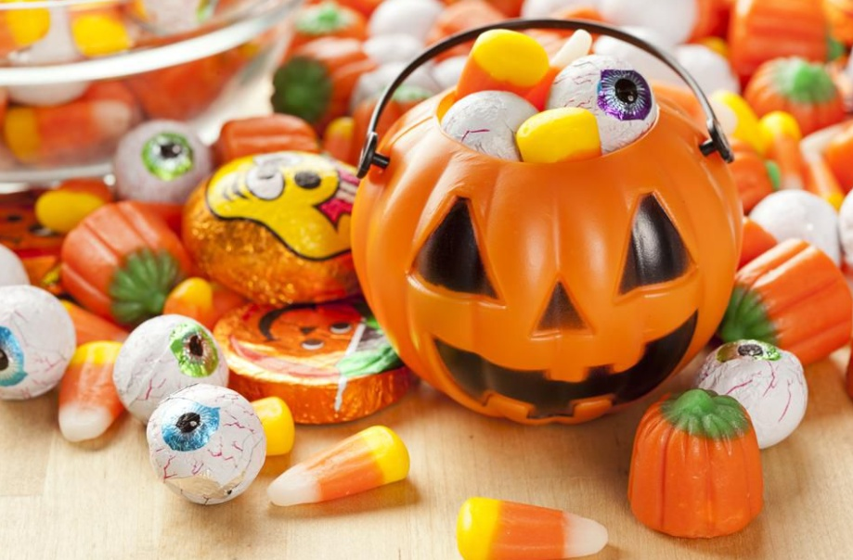
Halloween Candies – EDA & Basic ML
By: Vineeta Nair

Slide 2
Table of Contents
Problem Statement
Distribution spread of numeric features
Most Popular Candy Brands
Least Popular Candy Brands
Correlation between all features
Comparison of all features with win percent
Chocolate v/s Fruity
Percentage of Sugar content in candies
Top 10 most expensive candies
Most frequently used candy composition
Relationship of Sugar percent, Price percent with win percent
Performance of Regression models
Performance of Regression models post feature selection
Conclusion and Actionable Insights
Approach of the analysis
Reference websites

Slide 3
Problem Statement
This dataset consists of various types of Halloween candies. Data was collected by creating a voting website named 'walthickey' where participants were shown two fun-sized candies and asked to click on the one they would prefer to receive.
In our analysis through EDA and further through Predictive modeling we will find answers to our following questions,
Which is the most popular candy? and Which is the least popular?
Which quality/variety of candy are the most popular?
Sugar percentage in various candy brands and it's contribution to win percent.
Price percentage of candies and it's contribution to win percent.
Which are the most frequent/wining candy composition?
Predictive modeling by applying various algorithms and evaluating model performances.

Slide 4
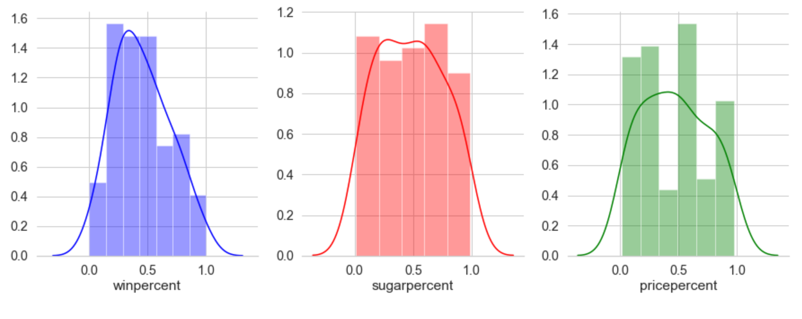
Distribution of Features
Win percent is normally distributed.
Sugar percent is uniformly distributed across all candies.
Similarly, prices of most of the candies are evenly spread.
This fulfils our Assumption#2; target variable should be normally distributed.

Slide 5
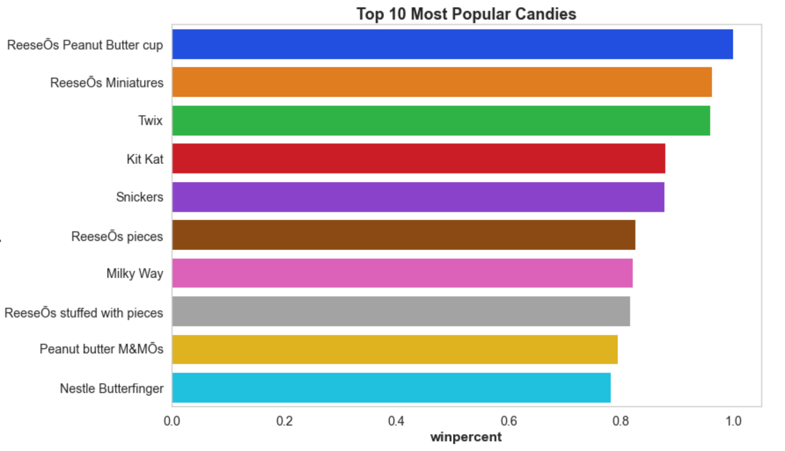
Most Popular Candy Brands
Reese's Peanut Butter cup is most popular candy with 84% wining percent. Followed by Reese's miniature and Twix in the second place at 81%.

Slide 6
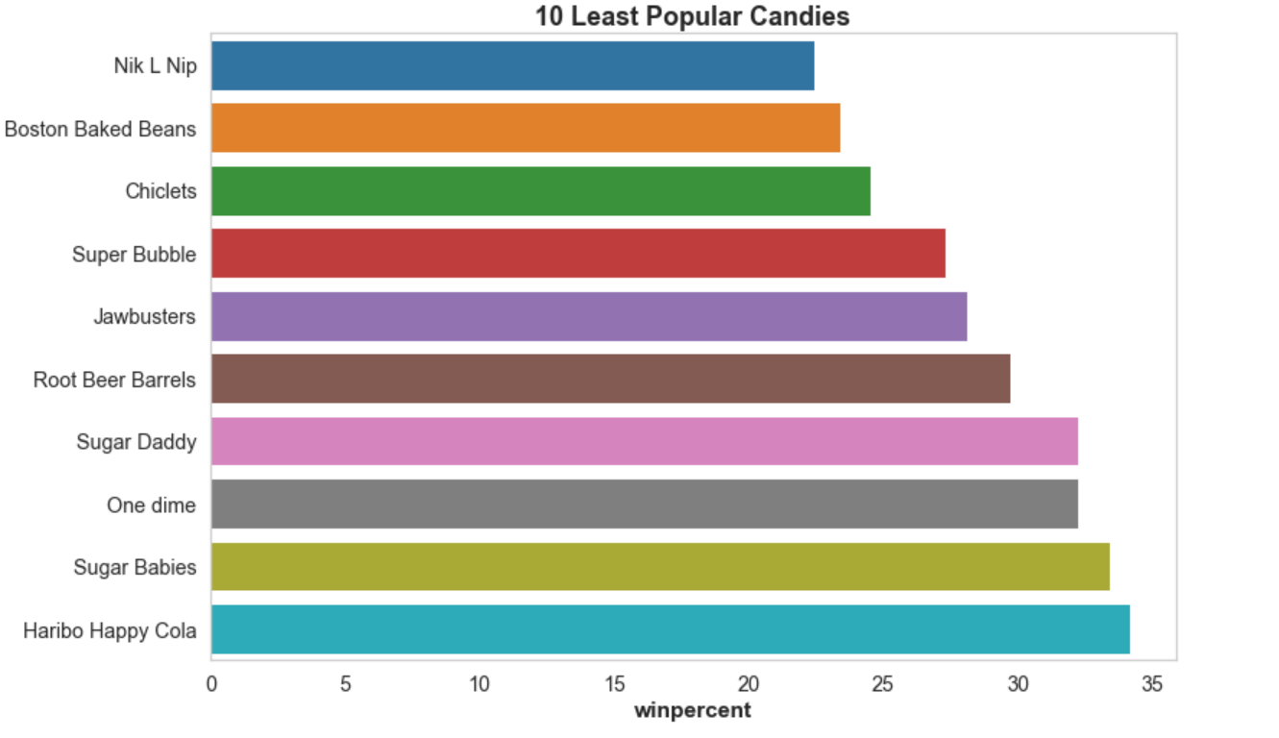
Least Popular Candies
‘Nik L Nip' is the least popular candy with wining percent of only 22%.
Followed by ‘Boston Baked Beans’ candy brand disliked at 23%

Slide 7
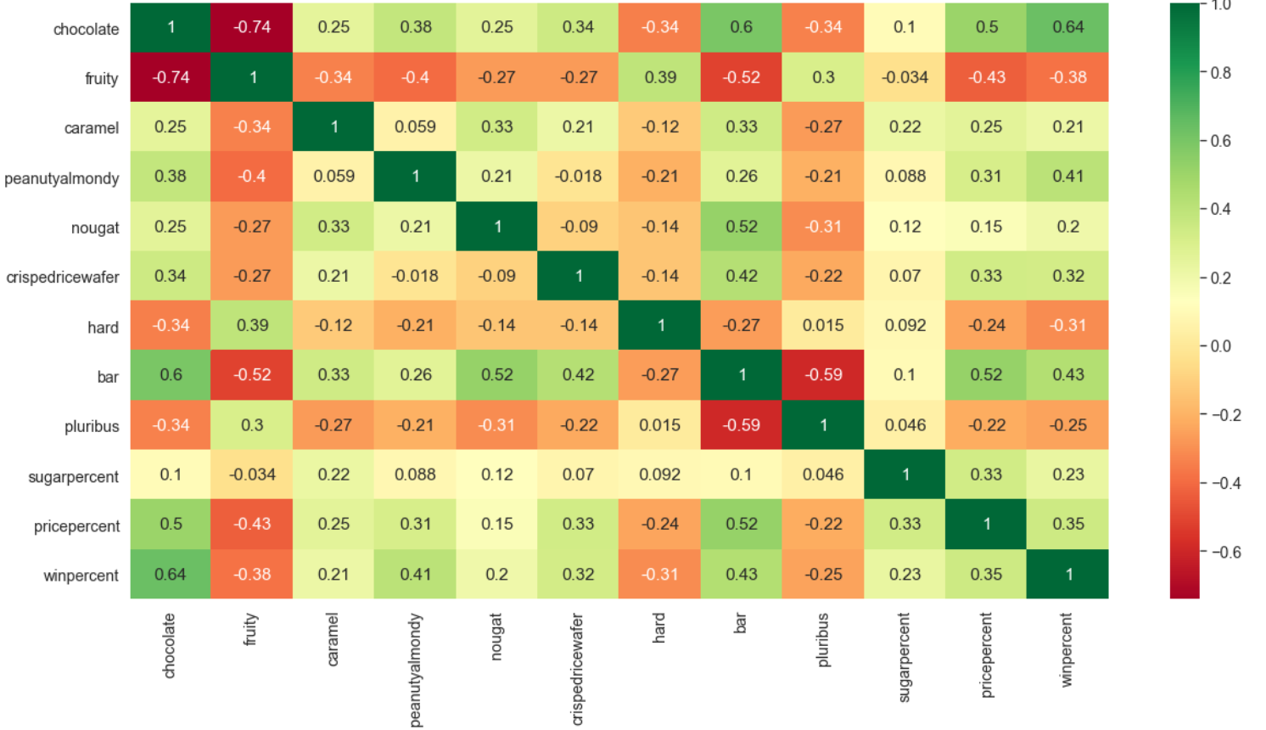
Correlation between all features
The above Heat map shows clear and high co-relation between Chocolate and the win percent with 64%.
PeanutyAlmondy with 41% and crispedricewafer (32%) are the next highly correlated with win percent.
Bar candies also are highly correlated with win percent with 43%.
It is noted that Chocolate candies are high priced.
Also, chocolate in bar combination are positively correlated than others.
Chocolate and Bar candies are highly priced with positive correlation.
It is observed that Chocolate and Fruity flavors have strong negative correlation of -0.74 as both these are 2 opposite components in a Candy which are rarely mixed. We will analyze this further if we would need to keep or drop one of these components.
It is also noted that Fruity, hard and pluribus varieties of candy has negative correlation with win percent.
All these 3 varieties in any candy have an inverse proportion to the wining percentage. We will further analyze each of these components in detail.
Sugar percentage does not have a strong correlation with any component except for price percent. It seems high priced candies are fairly high in sugar content.
All the above parameters needs to be further analyzed individually with win percent.

Slide 8
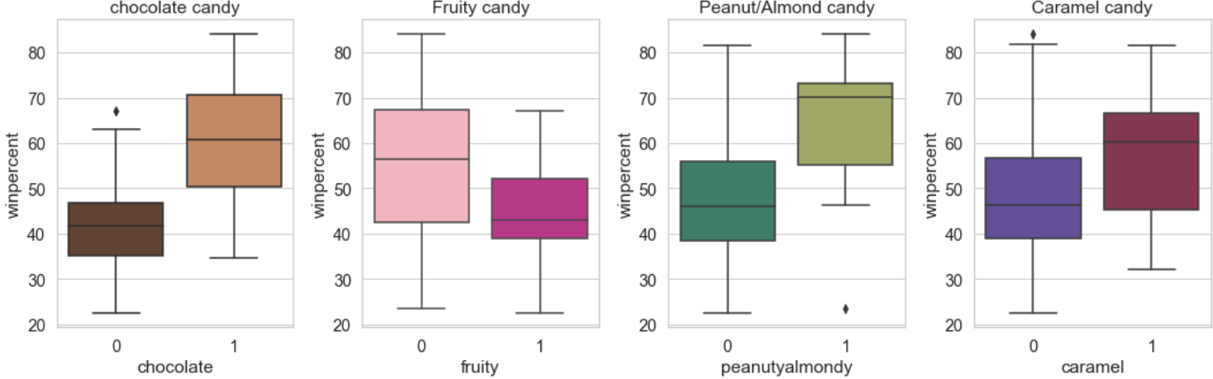
Univariate Analysis of candies with win percent
Box plots shows the variety of candies and its popularity amongst the population.
Candy containing Chocolate - more than 80% of population liked candies that contain chocolate. Hence, it is an important feature to consider.
Candy containing Fruity - around 50% of population liked candies that contain fruity flavor. Hence, it is an important feature to consider.
Candy containing Peanut/Almonds - more than 70% of population liked candies that contain peanut/almonds. Hence, it is an important feature to consider.
Candy containing Caramel - more than 60% of population liked candies that contain caramel. Hence, it is an important feature to consider.

Slide 9
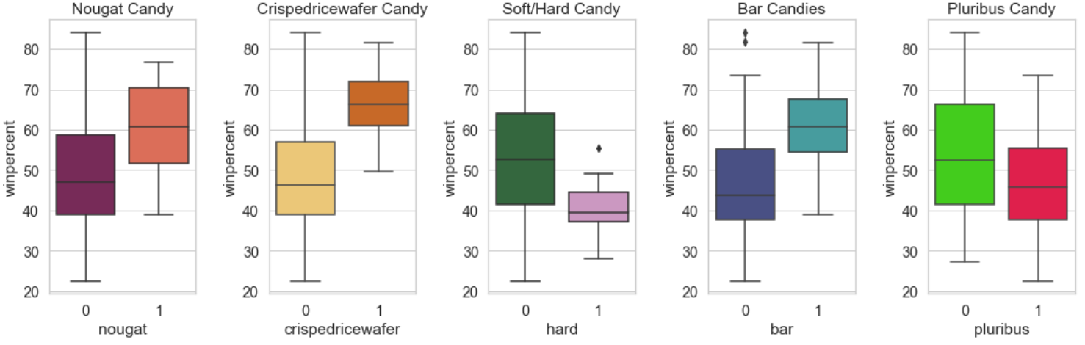
Univariate Analysis with win percent
Below box plots shows the variety of candies and its popularity amongst the population.
Candy containing nougat - more than 60% of population liked candies that contain chocolate. Hence, it is an important feature to consider.
Candy containing crispedricewafer - more than 70% of population liked candies that contain fruity flavor. Hence, it is an important feature to consider.
Hard Candy - not more than 60% of population liked hard candies. Hence, it doesn't seen to have a significant effect on win percent.
Bar Candy - more than 60% of population liked bar candies. Hence, it is an important feature to consider.
Candy containing pluribus - not more than 50% of population liked pluribus candies. Hence, it doesn't seen to have a significant effect on win percent.

Slide 10
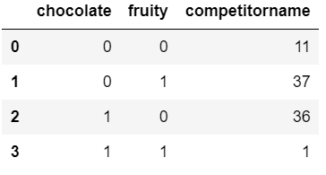
Chocolate & Fruity Candy Combination
This table shows that, there is only 1 candy with chocolate and fruity combination.
Hence, dropping either of the column may not be ideal as there are 37 & 36 of chocolate and fruity variety candies, which would be helpful in our analysis further.

Slide 11
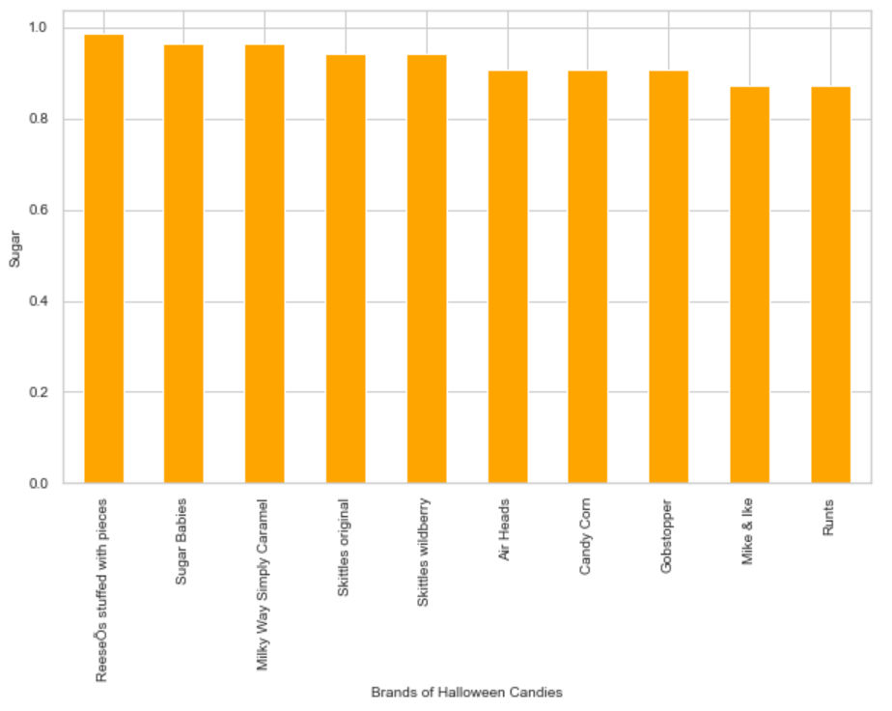
Sugar percent in candies
Below bar chart shows which top 10 candies brand has highest quantity of sugar percentage.
It is observed that mostly all the brands depicted below consist of sugar percent above 80%.
However, the highest sugar content is in the 'Reese's' brand of candies with 99% of sugar content. Reese's candy is followed by Sugar Babies and Milky way simply caramel with 96.5% of sugar content each.

Slide 12
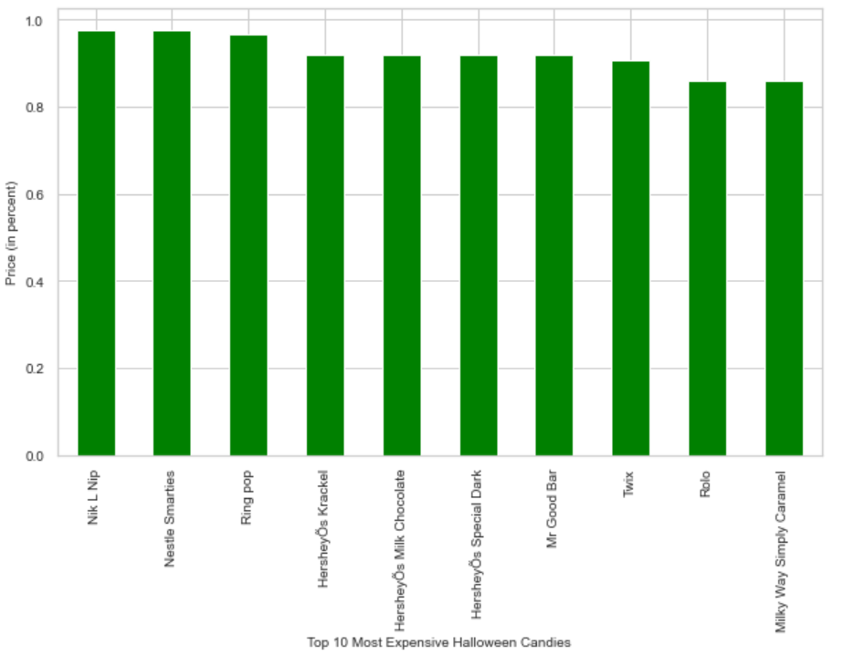
Top 10 Most Expensive Candies
Nik L Nip and Nestle Smarties are the most expensive brands of Halloween candies.

Slide 13
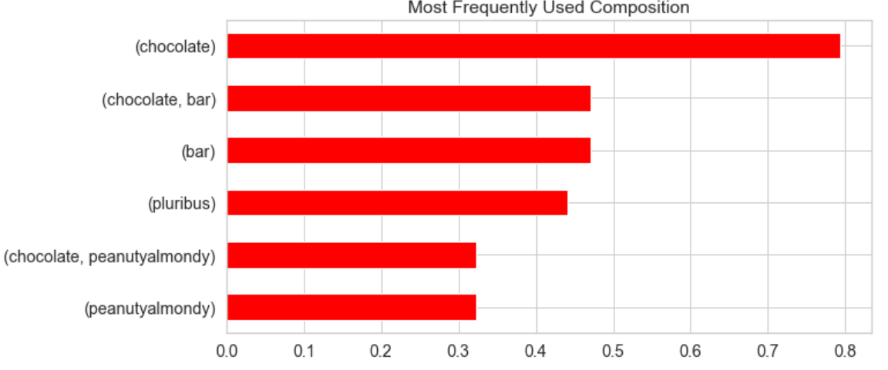
Most Frequently used Candy Composition
It is clearly visible from the below chart that Chocolate surely is the wining component in a Candy.
Second best wining component is the chocolate and bar composition.

Slide 14
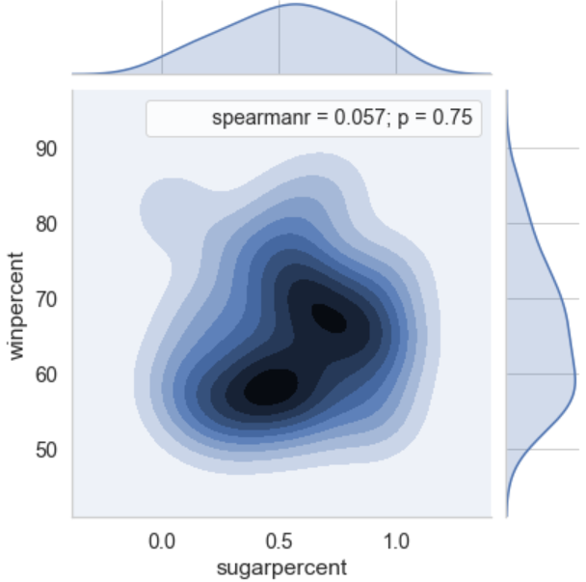
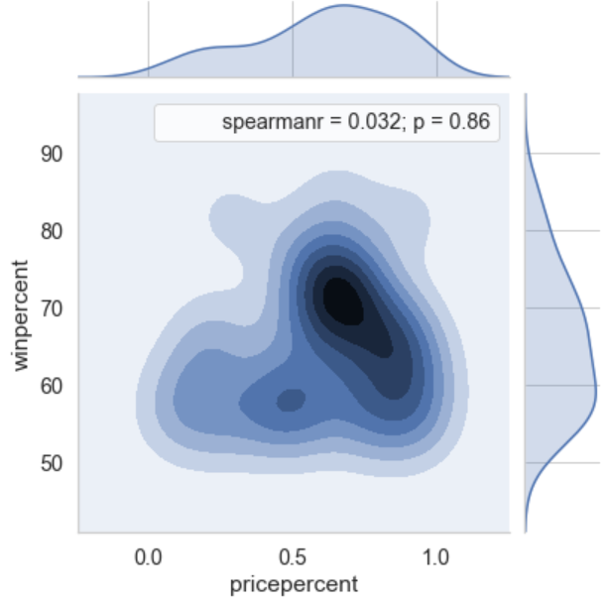
Sugar & price percent relationship with wining percent
Fig.1
Sugar percent vs. Win percent
This ‘kde’ chart shows sugar percent is not linear to the wining percent, i.e. sugar content of candy doesn't contribute to the popularity of the candy. (ref. fig.1)
Price percent vs. Win percent
This ‘kde’ chart shows price percent is not linear to the wining percent, i.e. price of candy doesn't contribute to the popularity of the candy. (ref. fig.2)
Fig.2

Slide 15
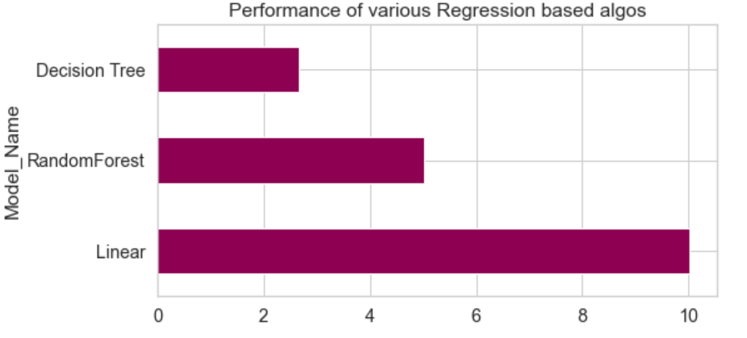
Performance of Regression based Algorithms
The below graph shows the training scores of each of the models.
Though the models performed well in the training set, it performed badly in the testing sample. This means that our models have over fitted the training set.

Slide 16
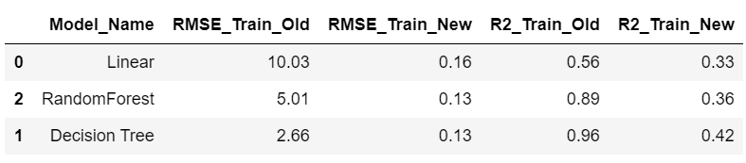
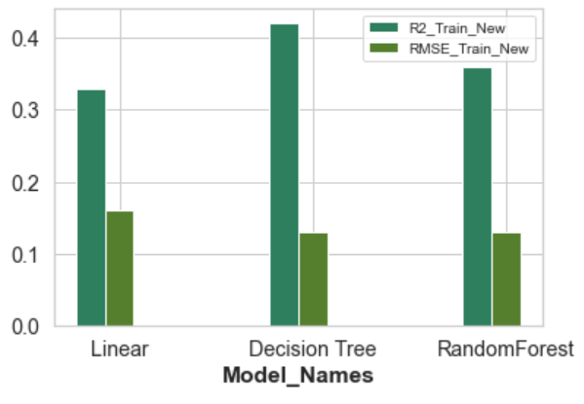
Performance of Regression models post feature selection
After eliminating 2 features (sugar & price percent), all the 3 models have shown good results.
New RMSE scores have reduced errors considerably in comparison with the old RMSE scores for Linear Reg, Decision Tree & Random Forest Algorithms.
Similarly, R squared scores have show good improvements for all the 3 models.
The above table and the bar graph shows that Decision Tree & Random Forest models are the best fit models.

Slide 17
Conclusion & Actionable Insights
Conclusion:
This is to conclude that, sugar and price percentages did not contribute to the wining candy percentage.
It was also clearly evident that chocolate candies have always been the winner with high wining percent. It was followed by chocolate and bar combination of candies.
We saw through EDA that, we could ascertain the most popular brand of candy and least favorites.
We also could infer the most favorite varieties of candies amongst the masses.
Actionable Insights:
Though the predictive modeling gave us a fairly best fit models, there is a scope for further improvements by reducing errors and increasing the R squared score.
It would help to reduce model flexibility through further Feature selection with appropriate Feature engineering methods.

Slide 18
Approach
Define Problem – After understanding the Halloween candies dataset and visiting the voting website, arrived at the problem statement and few questions.
Choosing Right Tools – Imported all the required packages such as NumPy, Pandas, Itertools, Matplotlib and Seaborn for visualization purposes and Sci-kit learn for Machine learning
Data Collection & Description – Imported Halloween Candies dataset from GitHub.
Data Analysis & Visualization with EDA –
Listed down questions basis of observations on data description.
Analyzed them with various pandas functions, NumPy arrays.
Percentage calculations and plotted graphs to infer observations.
Standardized columns for better analysis and comparison purpose.
Comparisons of various candies & its flavours with the target variable win percent to derive findings.
Ascertain relationship between all the independent variables with the dependent variable.
ML Basics –
Applying ML Basics by using Regression models such as Linear, Decision Tree & Random Forest.
Cross validation through splitting train & test samples.
Applied scaling to bring the target variable in the same scale by using min/max scalar.
Using the Models for prediction
Applied Model Evaluation techniques, MAE, MSE, RMSE & R squared to evaluate the model performances.
Applied Hyper-parameter tuning using ‘GridSearchCV’ & ‘RandomSearchCV’ methods.
Feature Selection –
To improve model performance, dropped sugar and price percent columns.
Applied and predicted models and gauged performance through evaluation techniques.
Conclusion /Summarization –
Summarized the EDA and model performance and predictions with findings.
Actionable Insights – Derived actionable insights in accordance to the findings on the detailed analysis and model prediction.

Slide 19
References
You can visit the voting site to get an idea. walthickey.com/2017/10/18/whats-the-best-halloween-candy/
Dataset/Coding references: Github, kaggle, stackoverflow.com

Slide 20
Thank you!

